Slide 1


Inverse participation ratios of coherent states
Weekly report
Miguel de Jesús González Martínez
miguel.gonzalez@correo.nucleares.unam.mx
20/11/2024

Slide 2
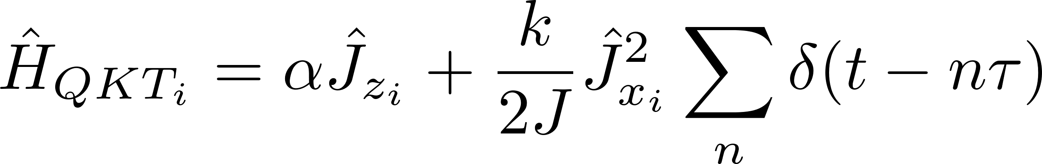
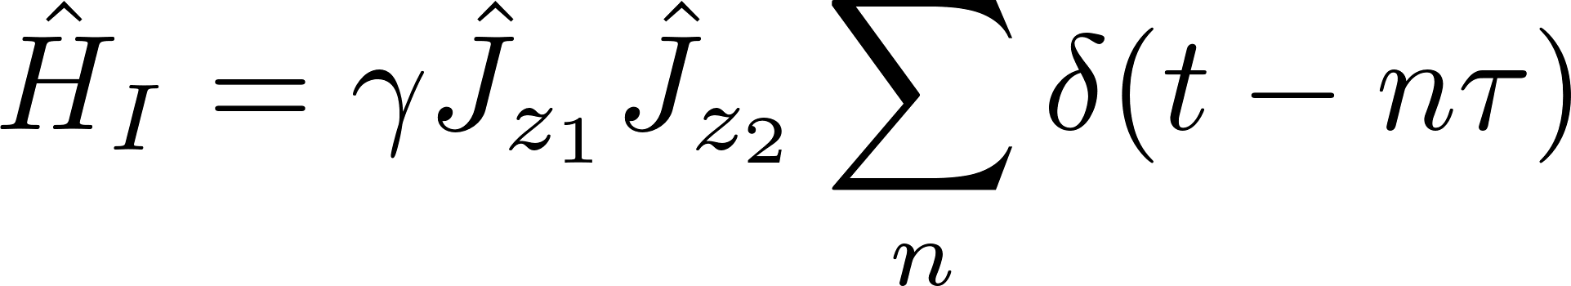
Problem of interest
Study the dynamics of the coupled kicked top from the perspective of an open quantum system

Slide 3
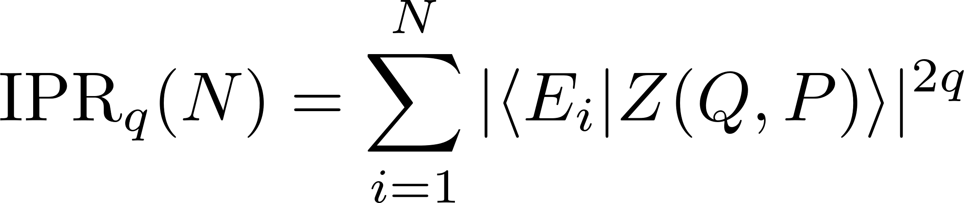
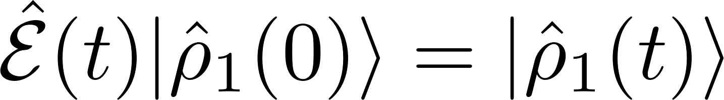
Problem of interest
With the total Floquet operator defined, we are interested in studying two things
Fractal properties of coupled spin coherent states
Quantum dynamical map
Vectorized form

Slide 4
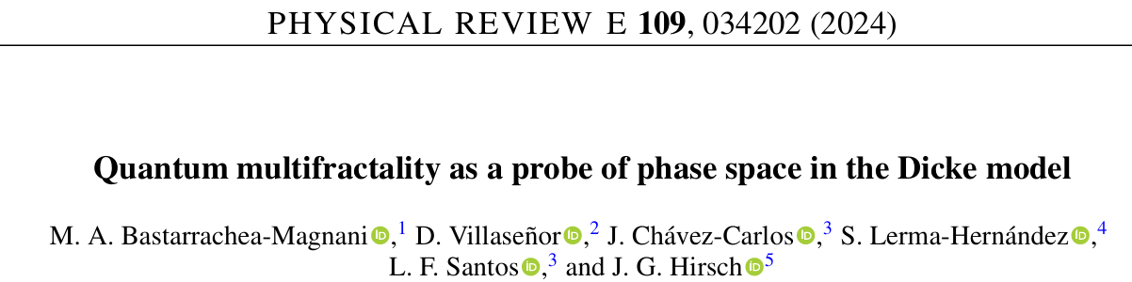
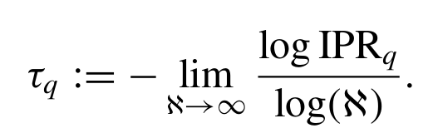
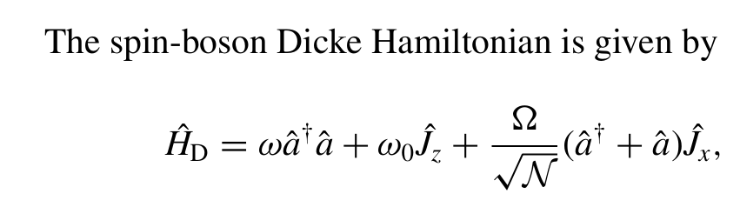
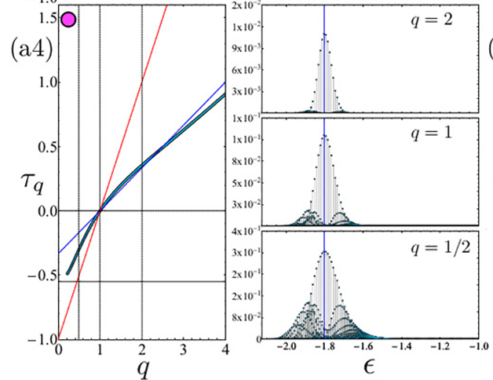
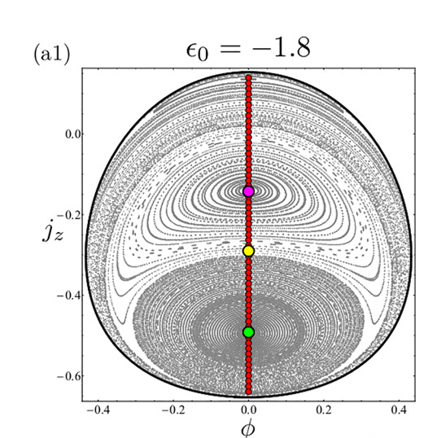

Slide 5
